Slide 1


BJIT Academy Mail Configuration in Thunderbird
Created By: BJIT IT

Slide 2
Thunderbird is a free email application that’s easy to set up and customize - and it’s loaded with great features! Download source: https://www.thunderbird.net/en-US/

Slide 3
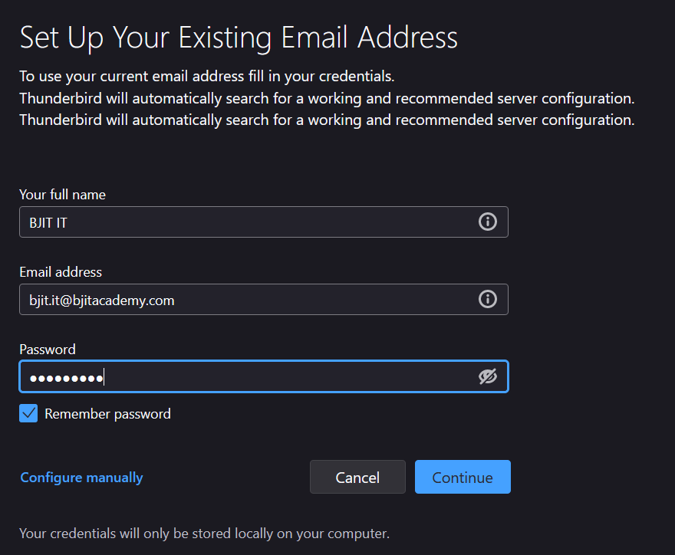
Enter your name and Email address
Then click “Configure Manually”

Slide 4
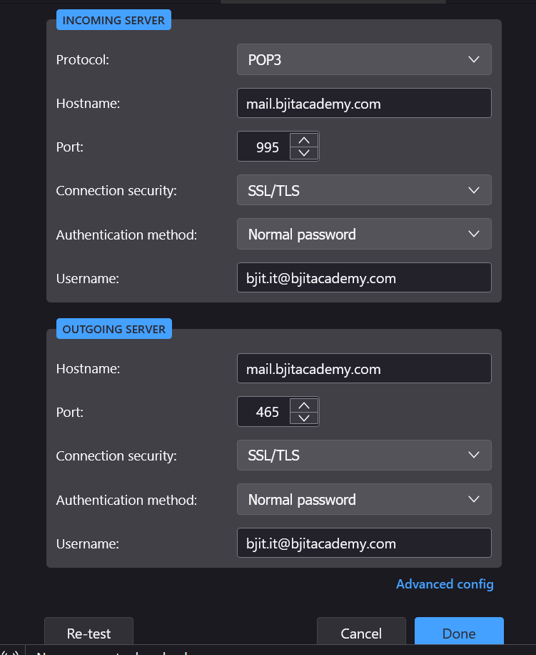
Please, input port , server name and other info according to The picture. ( Incoming Server and Outgoing Server)
2. Click “Re-test”
3. Click “Done”

Slide 5
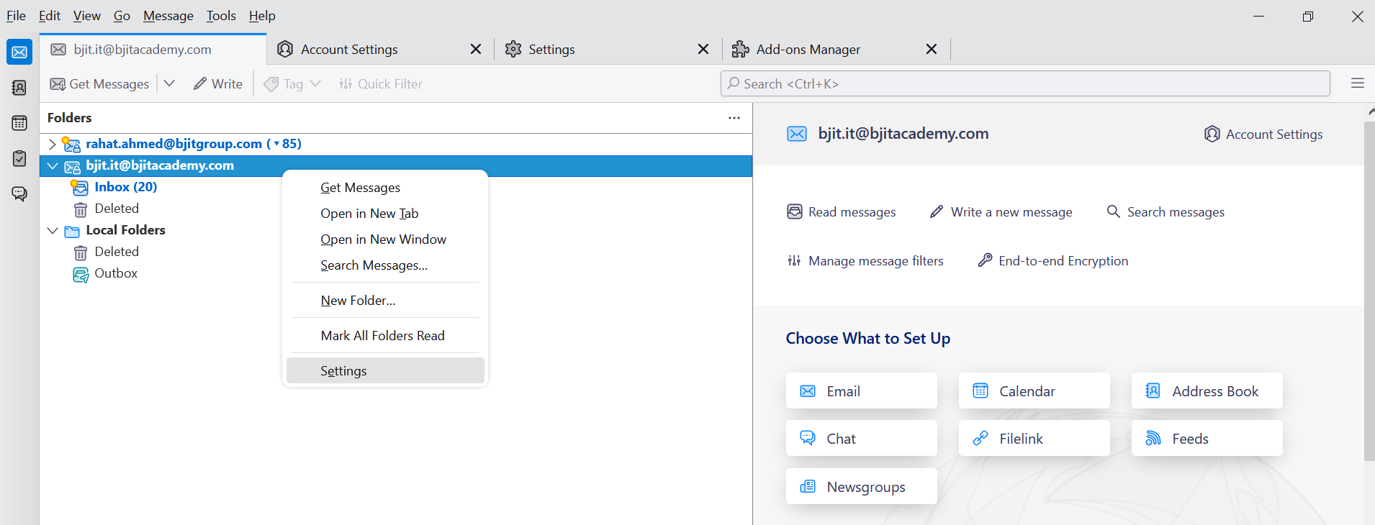
1. Right click on “Email Address” 2. Go to “ Settings”

Slide 6
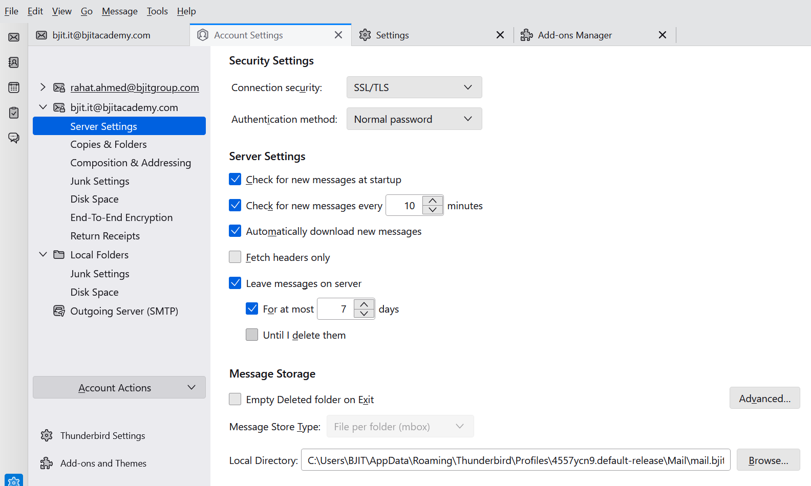
1. Click on “ Server Settings” 2. Uncheck the option “Until I delete them” 3. Insert value “7 days” According to the attached picture.

